Slide 1
Transformer and Foundation Models in NLP
Week 16

Slide 2
Outline
Overview of Language Models
What are Language Models?
LSTM and RNN
Encoder and Decoder
Self-attention
Training Transformer Models
Transformers
BERT
Overview of Large Language Models
BERT
Simple Transformers
Assignment - Text Classification

Slide 3
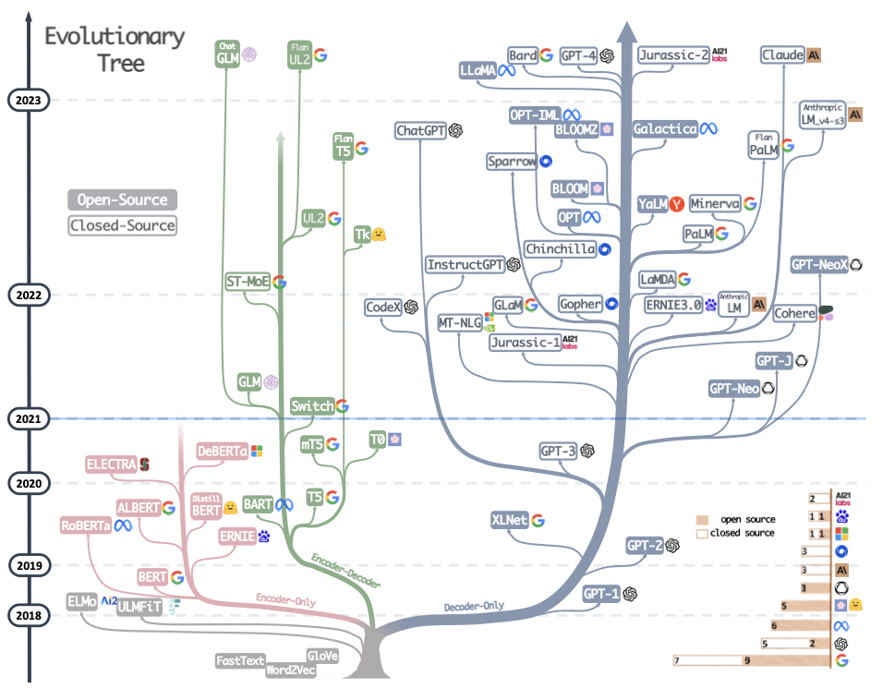
Large Language Models (LLMs)
https://arxiv.org/pdf/2304.13712.pdf

Slide 4
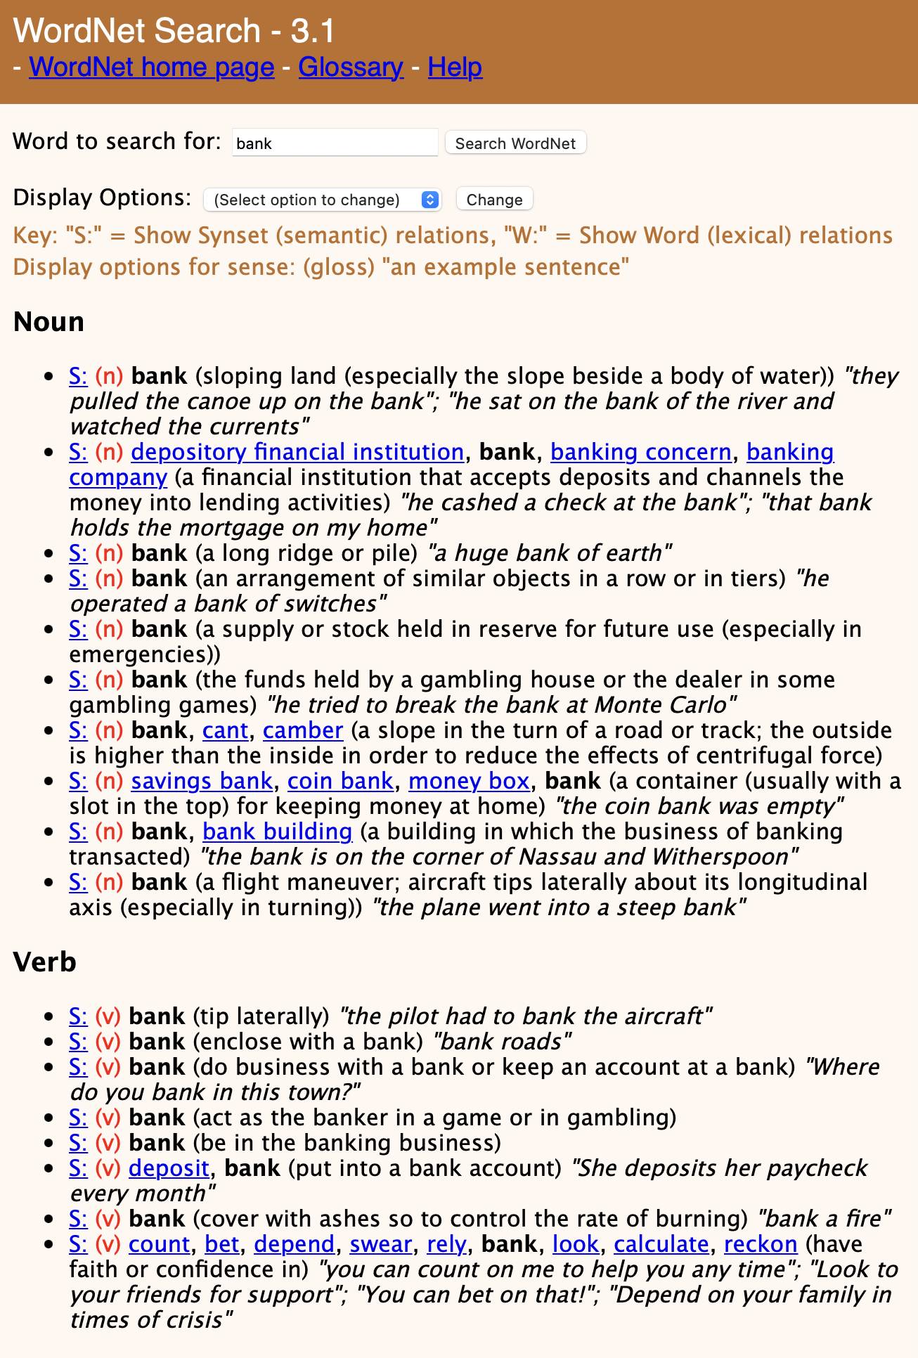
What are Language Models?
A type of artificial intelligence technology used to understand, interpret, generate, and respond to human language, Core of modern NLP applications
How do we best represent the “meaning” (semantics) and “structure” (syntax) of human language?
Senses of the word “bank” from WordNet
Source: http://wordnetweb.princeton.edu/perl/webwn?s=bank&sub=Search+WordNet&o2=&o0=1&o8=1&o1=1&o7=&o5=&o9=&o6=&o3=&o4=&h=
Notes:
As an alternative, contextual embeddings or contextualized embeddings were developed, where the details of a word embedding depend on the word itself as well as on the neighboring

Slide 5
What are Language Models?
What are the necessary components that should be modelled to identify the accurate semantics?
Position
Words before
Words after
Sentence(s) before..
Sentence(s) after..
How do we do this effectively and efficiently?
Source: http://wordnetweb.princeton.edu/perl/webwn?s=bank&sub=Search+WordNet&o2=&o0=1&o8=1&o1=1&o7=&o5=&o9=&o6=&o3=&o4=&h=
Notes:
As an alternative, contextual embeddings or contextualized embeddings were developed, where the details of a word embedding depend on the word itself as well as on the neighboring

Slide 6
Language Models
Model the probability of word sequence
Predict the word that comes after
Recurrent Neural Networks (RNN)
Long Short-term Memory Networks (LSTM)
Designed to train “language models” that process human language to conduct various tasks, such as classification, prediction, summarization, topic modeling
He sat on the bank of the
river
The pilot had to bank the
airplane

Slide 7
RNN and LSTM
He sat on the bank of the river
Word order modeled in hidden state
Issues with dealing with hidden states
Contextual Understanding
Handling Ambiguity in Language
P(W|“He”)
P(W|“He”, “sat”)
P(W|“He”, “sat”, “on”)
softmax
softmax
softmax
RNN
RNN
RNN
“He”
“sat”
“on”

Slide 8
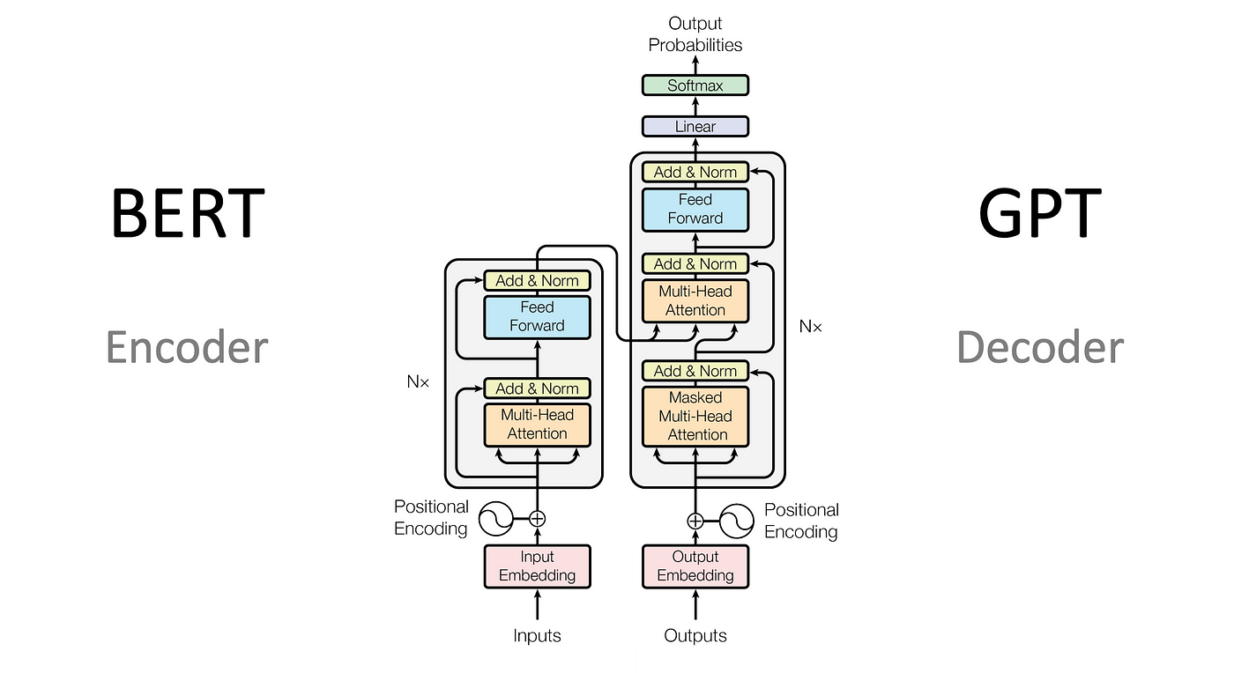
Transformer models

Slide 9
Transformer Models: Encoder and Decoder
Extends LSTM/RNN based language model to process word input more effectively and efficiently
Left to right, right to left
Remove the recurrence
Attention feature to identity important words in the context
Encoder and Decoder Architecture
Encoder only model: e.g., BERT
Decoder only model
Encoder-Decoder model

Slide 10
Transformer Models: (1) Self-Attention
Attention is the taking possession by the mind, in clear and vivid form, of one of what seem several simultaneously possible objects of trains of thoughts. Focalization, concentration of consciousness are of its essence (William James, 1980, Principles of Psychology)
In machine learning?
Notes:
It does this by assigning weights to input features based on their importance and their position in the sequence.

Slide 11
Transformer Models: (1) Self-Attention
Attention in transformers involves dynamically weighting the importance of different elements in the input data.
The model “attends” more to certain parts than others, based on their relevance to the task at hand.
“The cat on the mat.”
Focus on the relevant parts of a text simultaneously
Enhanced understanding of context
Various tasks
sat
LSTMs
Notes:
If we break transformers down into a “communication” phase and a “computation” phase, attention would represent the “communication” phase. In another analogy, attention is a lot like a search-retrieval problem, where given a query, q, we want to find the set of keys, k, most similar to q and return the corresponding values, v.

Slide 12
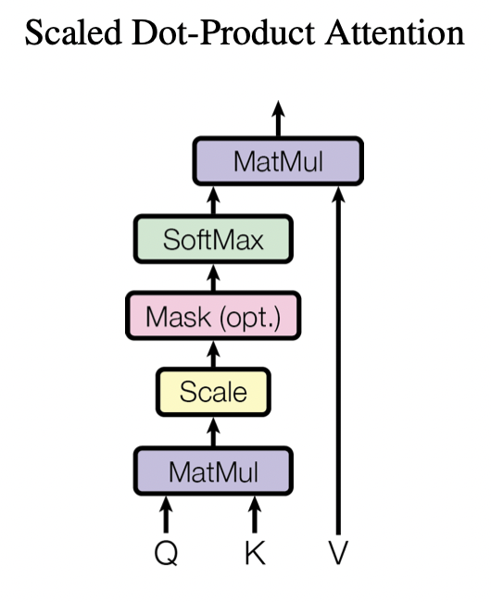
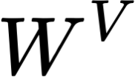
Transformer Models: (1) Self-Attention
Three key vectors for each embedding:
Query ( ) - What are we looking for?
Key ( ) - What do I have?
Value ( ) - What can I communicate?
Attention functions maps a query and a set of key-value pairs to an output
Scoring
Normalization and Weight Calculation
Weighted Sum and Output Generation
Notes:
If we break transformers down into a “communication” phase and a “computation” phase, attention would represent the “communication” phase. In another analogy, attention is a lot like a search-retrieval problem, where given a query, q, we want to find the set of keys, k, most similar to q and return the corresponding values, v.

Slide 13
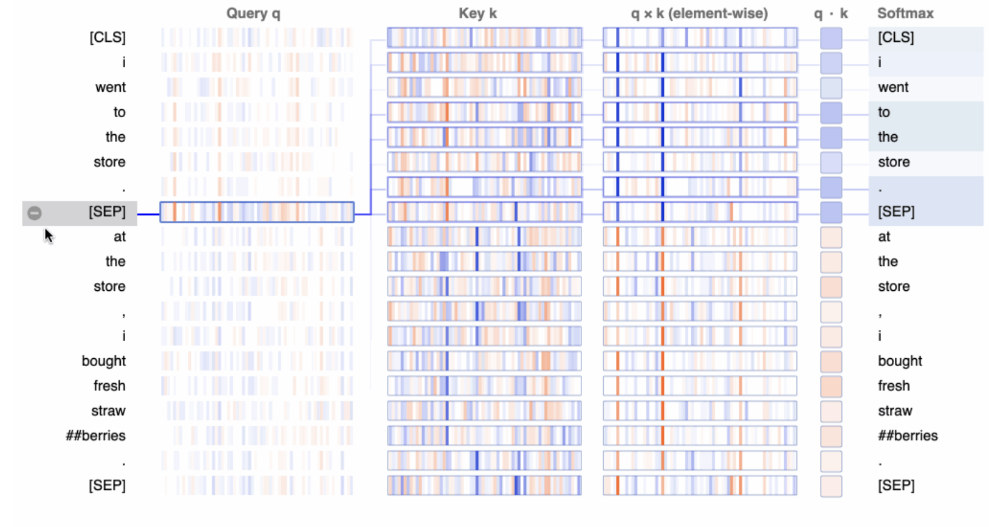
Attention Mechanism and Transformer Models
Self-attention to Generate Contextual Embedding
BertViz (2017)
“I went to the store. At the store, I bought fresh strawberries.”
https://www.comet.com/site/blog/explainable-ai-for-transformers/

Slide 14
Transformer Models: (2) Encoder and Decoder
Transformer models use encoder stack to model input;
Transformer models use decoder stack to model output
Inside an Encoder
Neural network layers that takes input word/token sequence to produce continuous embedding
Feed Forward NN
Feed Forward NN
Feed Forward NN
Self-Attention
“He”
“sat”
“on”

Slide 15
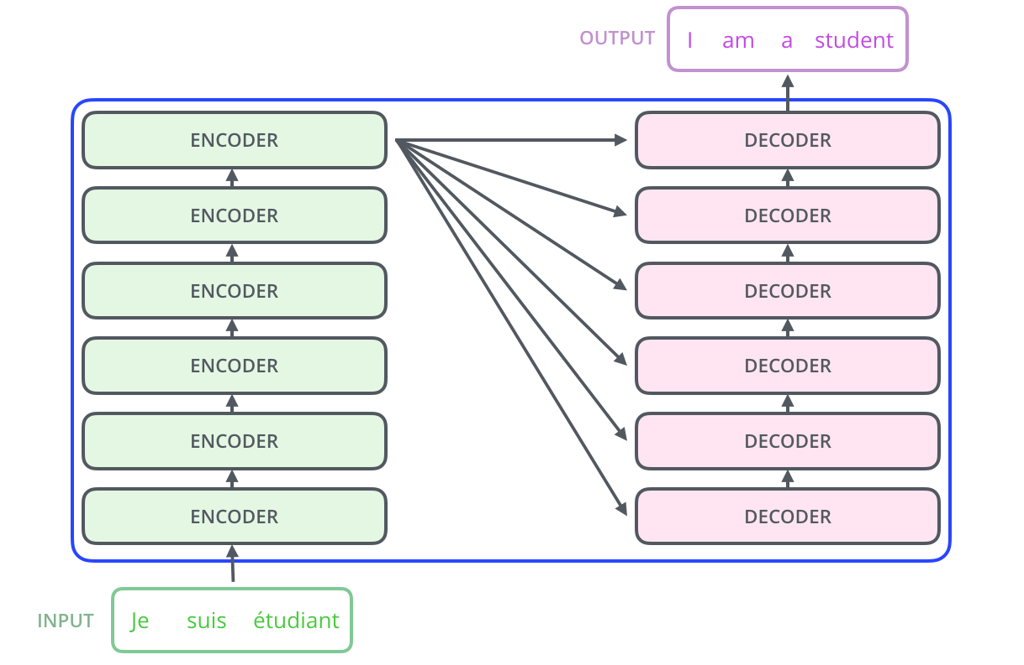

Slide 16
What are the existing models? How to Train?
Transformer models are typically created using semi- or unsupervised learning with a very large collection of corpora
Fine-tuning is required in order to tackle specific tasks

Slide 17
Large Language Models (LLMs)
and NLP Tasks

Slide 19
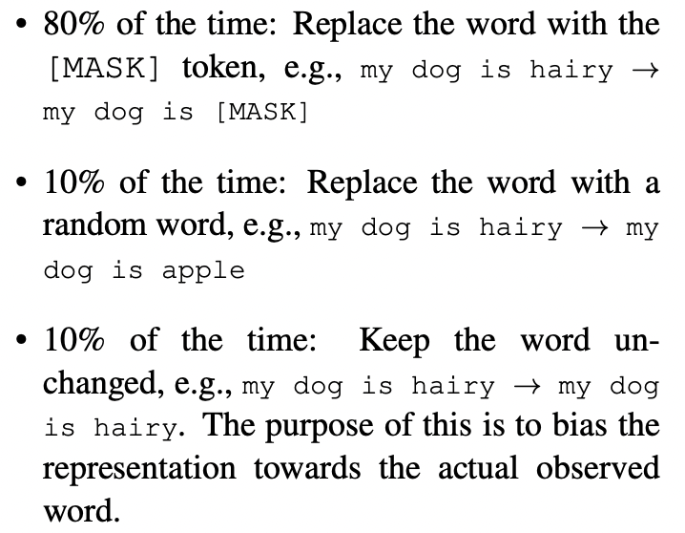
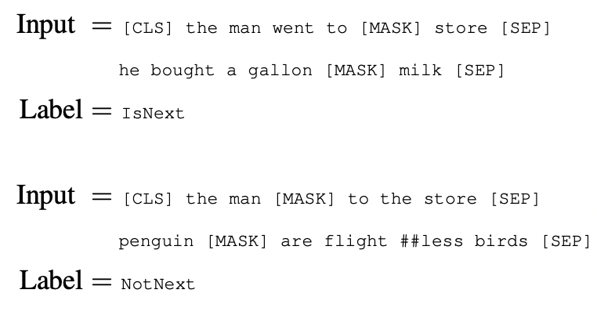
Bidirectional Encoder Representation from Transformers
BERT (Devlin et al., 2018) pre-trained based on the two unsupervised tasks:
Masked Language Model
Masking certain words randomly (~15%) in text and trying to “recover” these words
The cat sat on the ____
Next Sentence Prediction
Focusing on bullet-proofing the model for tasks that require understanding the relationship between the components of text (e.g., sentences)
I spilled coffee on my shirt. __________

Slide 20
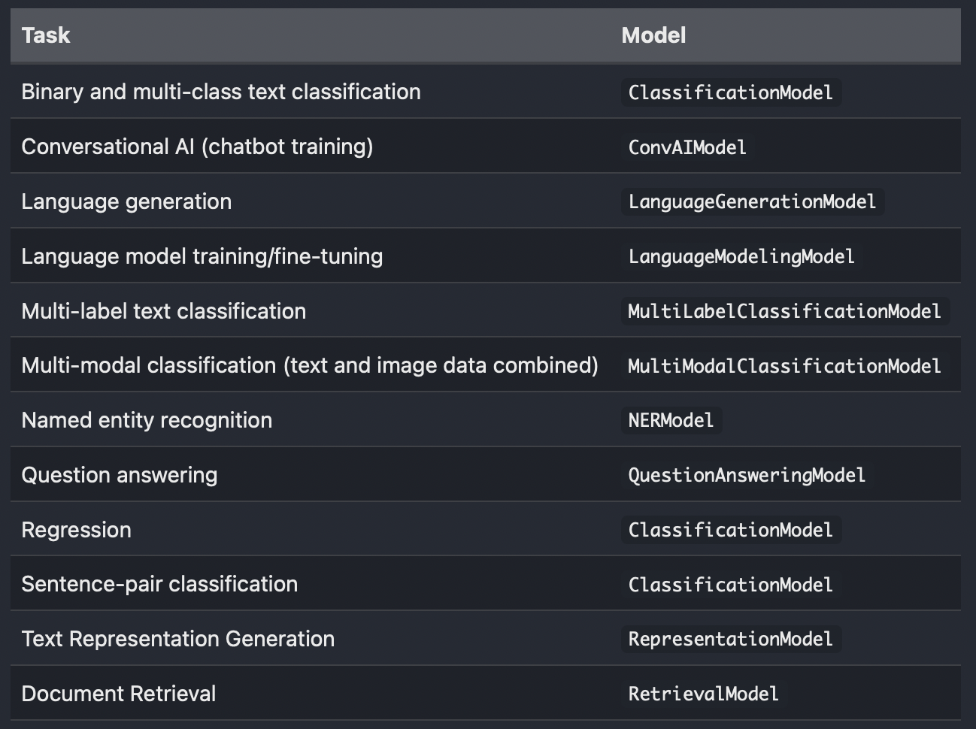
SimpleTransformer for Assignment 1
Instruction: https://simpletransformers.ai/docs/usage/
Task-specific model with various pre-trained transformer models, including BERT

